Slide 1

SPADE food & supplements
Estimating the habitual intake distribution of combined intake from food and supplements

Slide 2
Outline 1. Overview submodels SPADE 2. SPADE for supplements 3. SPADE for food + supplements

Slide 3
Outline 1. Overview submodels SPADE 2. SPADE for supplements 3. SPADE for food + supplements

Slide 4
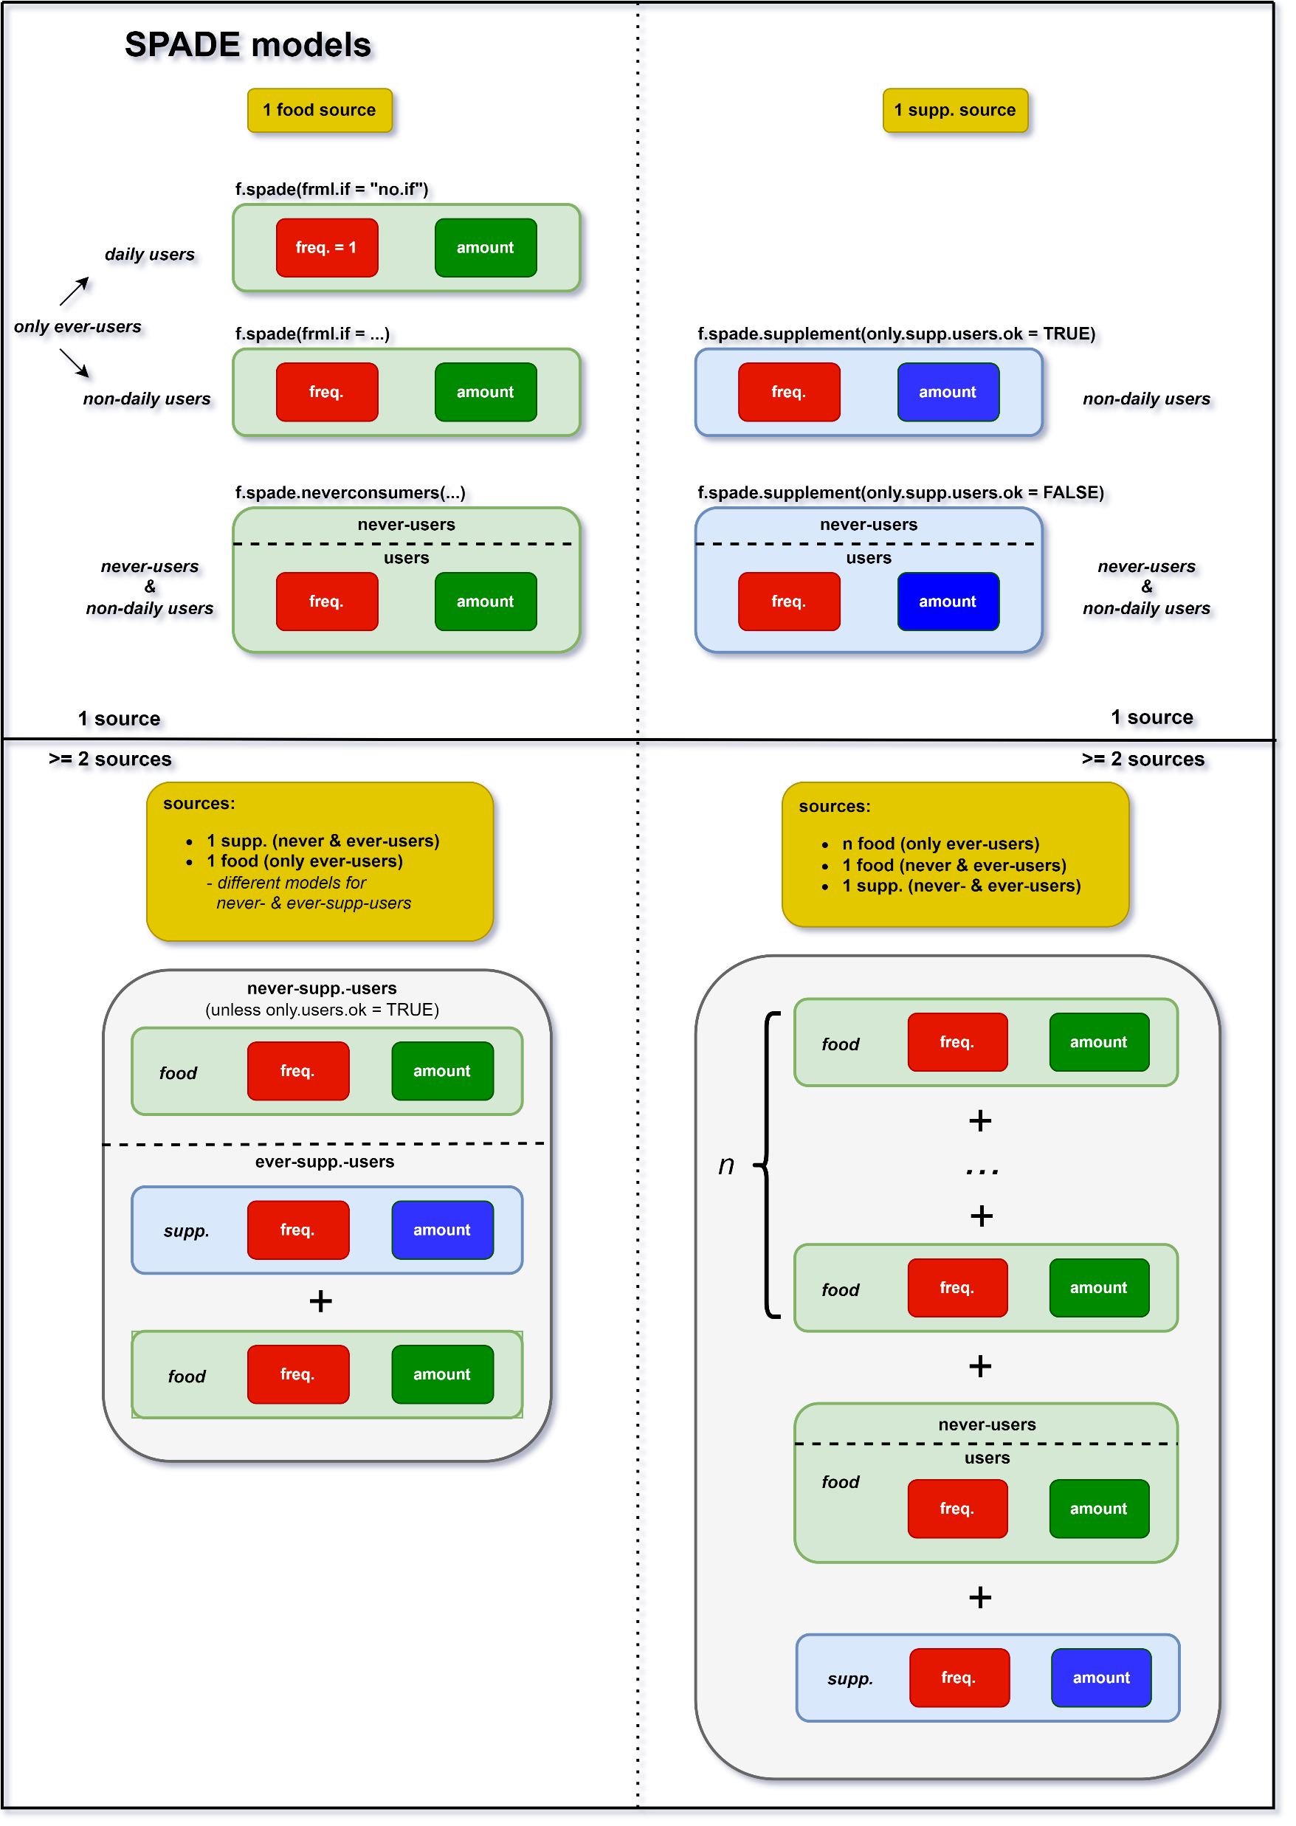

Slide 5
yesterday: SPADE for daily intakes, uses frml.if = “no.if”

Slide 6
*SPADE’s terminology: intake frequency = probability of positive intake frequency = 0: never consumed frequency = 0.5: consumed on 50% of day frequency = 1: consumed every day frequency > 1: impossible
this afternoon (optional): SPADE for non-daily intakes, uses frml.if = nutrient ~ cs(age)

Slide 7
SPADE for non-daily intakes with extra info on never-users (typically from FFQ). Example: alcohol Requires extra column in data that indicates never-users. Method: - for potential users: predict as before - For every age, add the perentage of never-users (HI = 0) found in the data.

Slide 8
this session: SPADE for intake from supplements -- episodical, possibly with extra info on never-users

Slide 9
in this session

Slide 10
not in this course

Slide 11
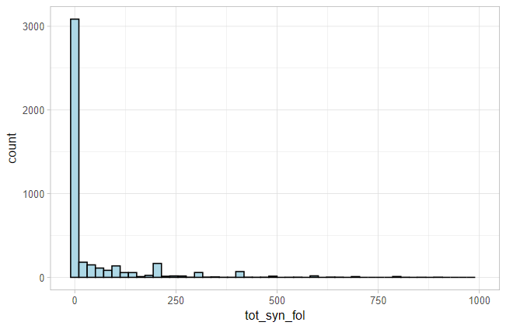
Example: synthetic folate intakes (females, age 1-79, ~Dutch population)
s_syn_fol
f.spade.supplements
Total intake

Slide 12
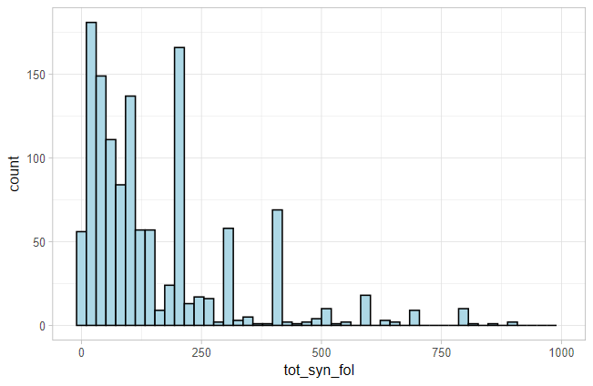
Example: synthetic folate intakes (females, age 1-79, ~Dutch population)
s_syn_fol
f.spade.supplements
Total intake (w/o zeroes)
Total synthetic folate intake

Slide 13
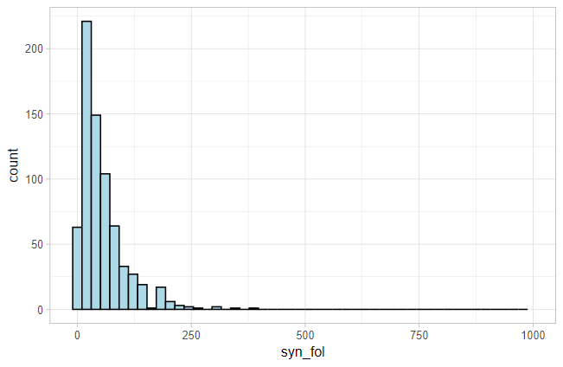
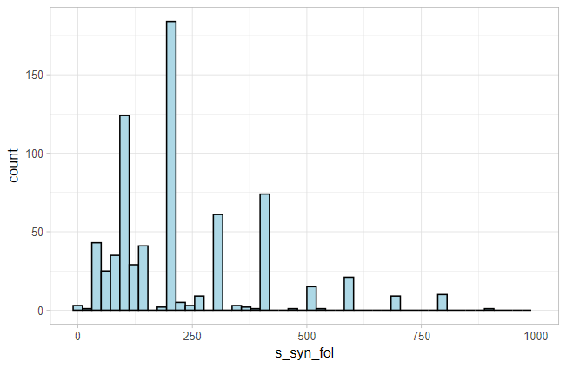
Example: synthetic folate intakes (females, age 1-79, ~Dutch population)
s_syn_fol
f.spade.supplements
Intake from food (w/o zeroes)
Intake from supplements (w/o zeroes)

Slide 14
Outline 1. Overview submodels SPADE 2. SPADE for supplements 3. SPADE for food + supplements

Slide 15
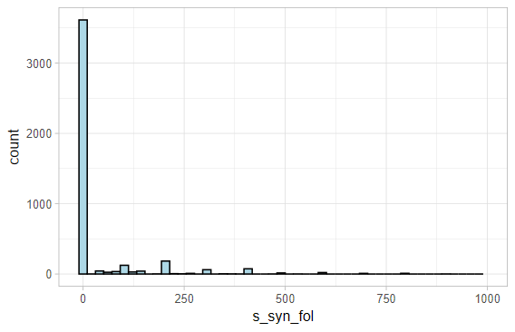
Example: synthetic folate intakes (females, age 1-79, ~Dutch population)
s_syn_fol
f.spade.supplements
Intake from supplements (with zeroes)
Intake from supplements (w/o zeroes)

Slide 16
How to model supplement intake?
Data Characteristics
NB: Only zero intakes does not mean never-user
Often many zero intakes
Often extra information on never supplement users (e.g. from FFQ)
Irregular histogram
If positive intake, the intake amount is often the same within one person (~70% of the time)

Slide 17
How to model supplement intake?
Data Characteristics
Modelling strategy
Often many zero intakes
Often extra information on never supplement users (e.g. from FFQ)
Irregular histogram
If positive intake, the intake amount is often the same within one person (~70% of the time)
Model intake frequency as before
Account for never-users as before
Non-parametric approach (stay very close to original data)
If positive intake, assume: habitual intake ≈ mean of observed intakes

Slide 18
How to model supplement intake?

Slide 19
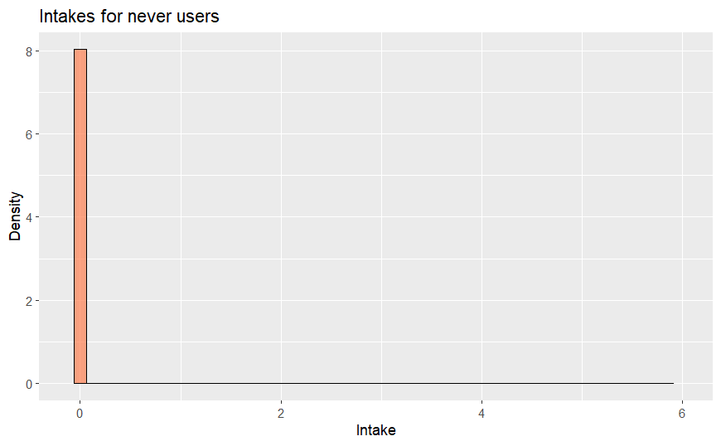
How to model supplement intake?
Modelling steps:
For every age: determine percentage of never-users.
HI distr. never-suppl. users
e.g. 25%

Slide 20
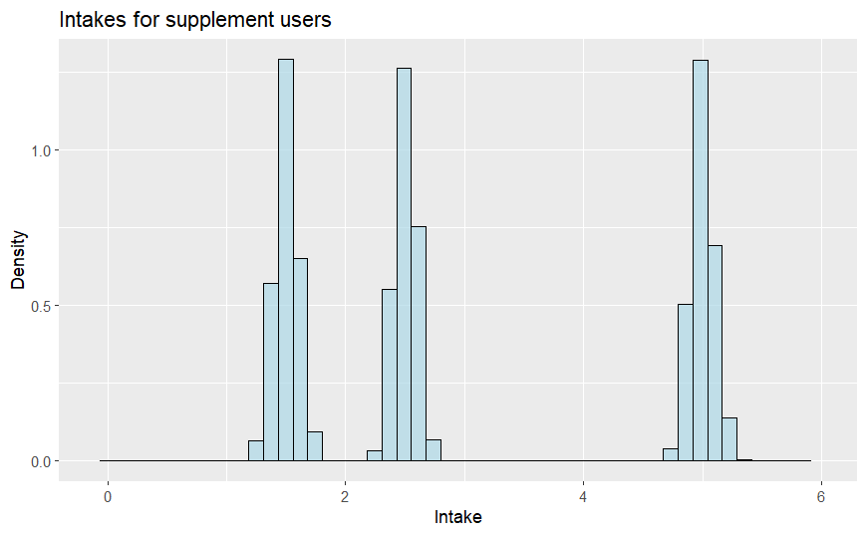
How to model supplement intake?
HI distr. never-suppl. users
Modelling steps:
For every age: determine percentage of never-users.
25% of population
Obtain HI distribution of (potential) supplement users.
HI distr. suppl. users

Slide 21
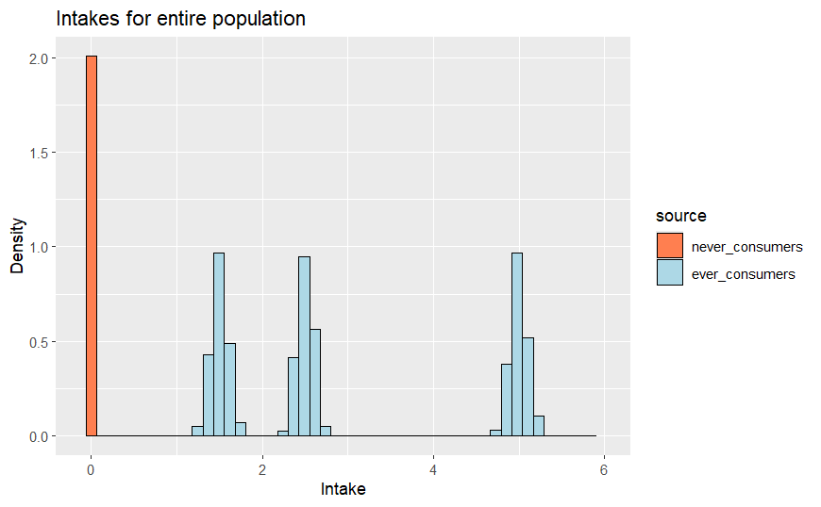
How to model supplement intake?
HI distr. never-suppl. users
Modelling steps:
For every age: determine percentage of never-users.
25% of population
Obtain HI distribution of (potential) supplement users.
For every age: combine the two distributions.
HI distr. suppl. users
HI distr. entire population
75% of population

Slide 22
How to model supplement intake?
Modelling steps:
For every age: determine percentage of never-users.
Obtain HI distribution of (potential) supplement users.
For every age: combine the two distributions.

Slide 23
How to model supplement intake?
Modelling steps:
For every age: determine percentage of never-users.
Obtain HI distribution of (potential) supplement users.
For every age: combine the two distributions.

Slide 24
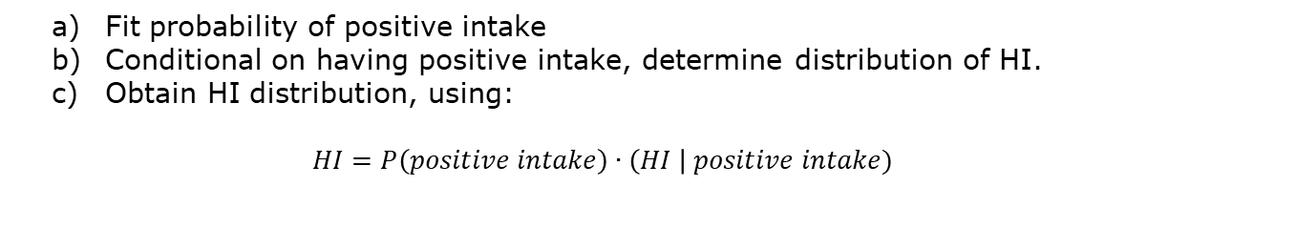
How to model supplement intake?
Modelling steps:
For every age: determine percentage of never-users.
Obtain HI distribution of (potential) supplement users.
Fit probability of positive intake
Conditional on having positive intake, determine distribution of HI.
Obtain HI distribution, using: $HI=P\left(positive intake\right) \text{∙} \left(HI \right| positive intake)$
For every age: combine the two distributions.

Slide 25
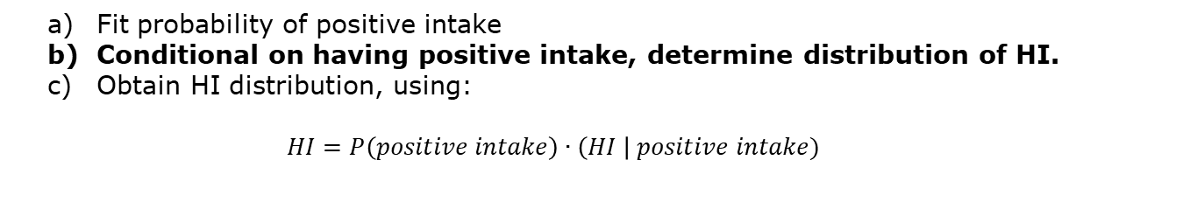
How to model supplement intake?
Modelling steps:
For every age: determine percentage of never-users.
Obtain HI distribution of (potential) supplement users.
Fit probability of positive intake
Conditional on having positive intake, determine distribution of HI.
Obtain HI distribution, using: $HI=P\left(positive intake\right) \text{∙} \left(HI \right| positive intake)$
For every age: combine the two distributions.

Slide 26
HI distribution conditional on positive intake
Approach:
Assign a habitual intake to every person in the dataset
Directly use these habitual intakes (empirical distribution)

Slide 27
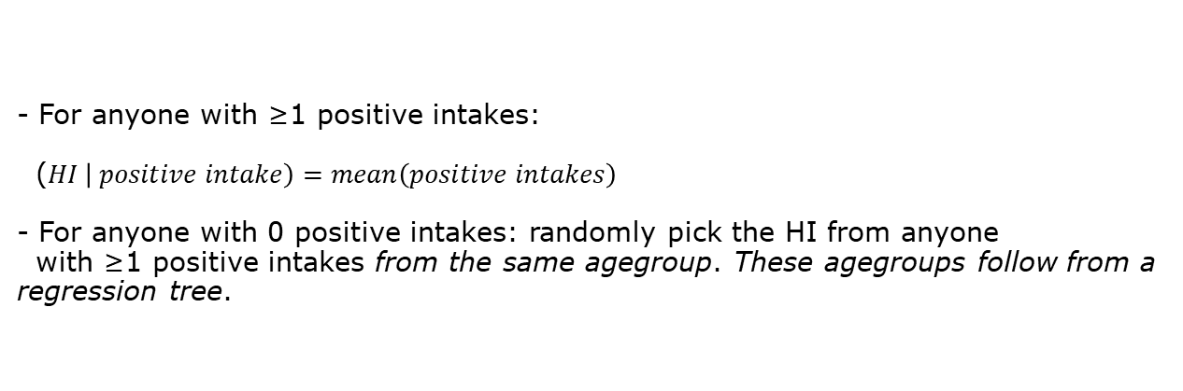
HI distribution conditional on positive intake
Approach:
Assign a habitual intake to every person in the dataset
- For anyone with ≥1 positive intakes: ($HI \left| positive intake\right)=mean\left(positive intakes\right)$ - For anyone with 0 positive intakes: randomly pick the HI from anyone with ≥1 positive intakes from the same agegroup. These agegroups follow from a regression tree.
Directly use these habitual intakes (empirical distribution)

Slide 28
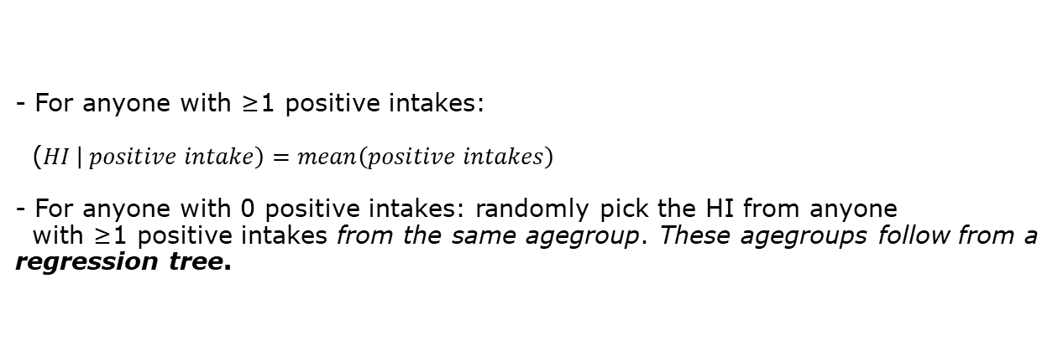
HI distribution conditional on positive intake
Approach:
Assign a habitual intake to every person in the dataset
- For anyone with ≥1 positive intakes: ($HI \left| positive intake\right)=mean\left(positive intakes\right)$ - For anyone with 0 positive intakes: randomly pick the HI from anyone with ≥1 positive intakes from the same agegroup. These agegroups follow from a regression tree.
Directly use these habitual intakes (empirical distribution)

Slide 29
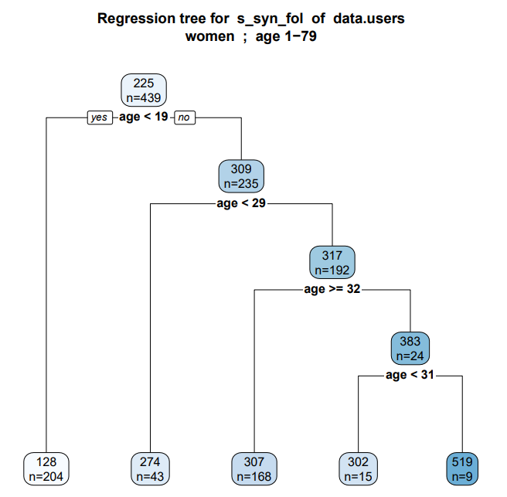
Regression tree:
among users with ≥1 positive intakes, finds agegroups with similar HI.
Resulting agegroups:
agegroup | mean HI
1 - 18 | 128
19 - 28 | 274
29 - 30 | 302
31 | 519
32 - 79 | 307

Slide 30
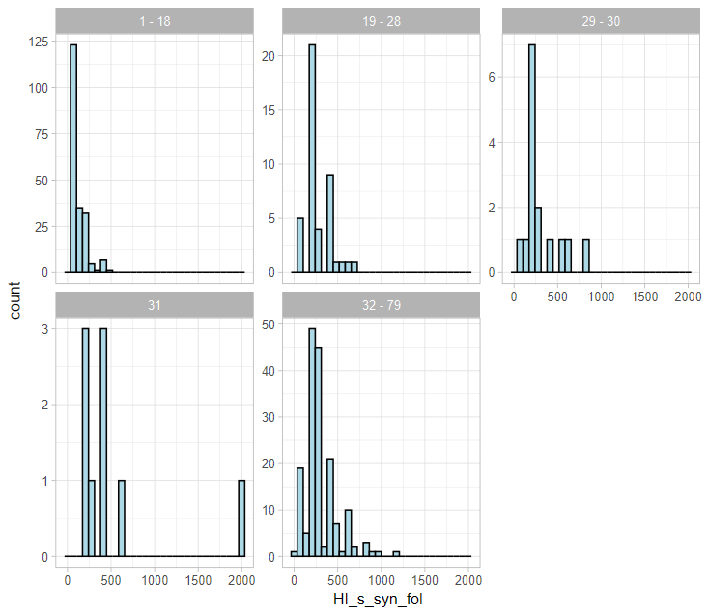
Regression tree:
Among users with ≥1 positive intakes, finds agegroups with similar HI.
HI histograms per agegroup
Resulting agegroups:
agegroup | mean HI
1 - 18 | 128
19 - 28 | 274
29 - 30 | 302
31 | 519
32 - 79 | 307
HI for users with only zero intakes is drawn from these

Slide 31
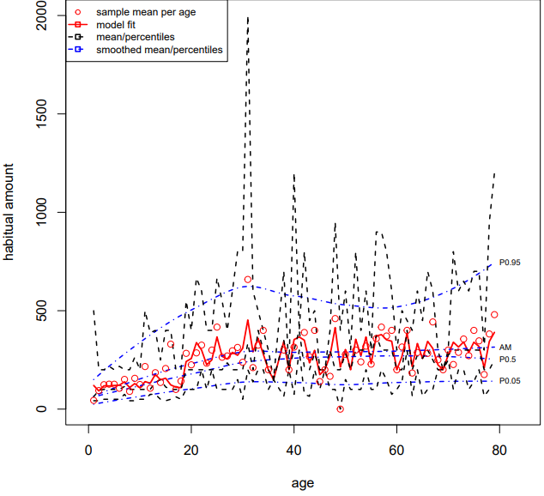
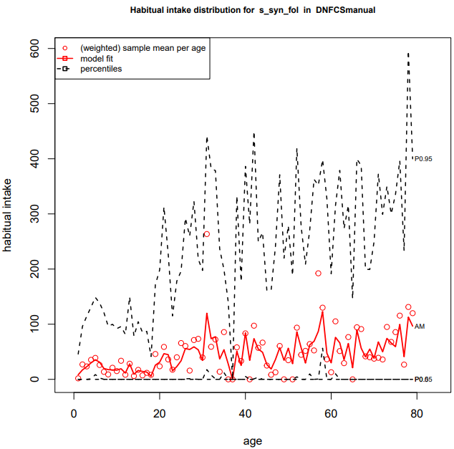
Habitual amount distribution (conditional on positive intake)
Habitual intake distribution

Slide 32
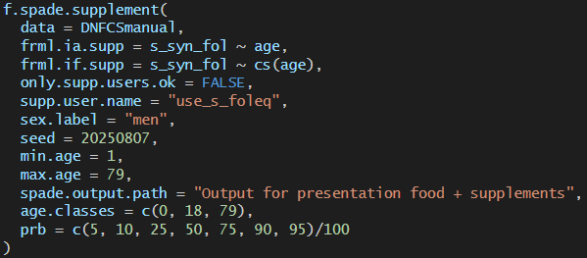
Exercise 1
For men in the age-ranges 1-18 and 19-79, find the following characteristics of the habitual intake distributions of synthetic folate supplements: mean (AM), P5, P10, P25, P50, P75, P90, P95. What features stand out?
Investigate for both groups: which is the first non-zero percentile? Possible (but false) answer: P41 and P24.
Can you explain why all lower percentiles are 0? How do you expect to see this in the data?
Hint: use the function f.spade.supplement. Useful arguments:
argument | Description / remarks
data | name dataset
frml.ia.supp | Formula to model the intake amounts, usually variable_name ~ age
frml.if.supp | Formula to model the intake frequencies, typically variable_name ~ cs(age)
only.supp.user.ok | Is everyone a supplement user? (TRUE/FALSE)
supp.user.name | Name of column that indicates whether someone is a supplement user (1) or not (0)
min.age / max.age | minimum / maximum ages used in analysis
sex.label | “men”/”male”, “women”/”female” or “both
age.classes | Age-classes to aggregate final results by
prb | Percentiles reported in the output. Default: prb = c(5, 10, 25, 50, 75, 90, 95) / 100
spade.output.path | Directory to save results
seed

Slide 33
Answer to exercise 1
Code:

Slide 34

Answer to exercise 1
Code:
Results (from tab “HI” of saved excel-file)

Slide 35
Answer to exercise 1
Code:
Results (from tab “HI” of saved excel-file) Things to note:
Mean HI is higher for adults than for youth
At least 50% of people have HI = 0
P75 is still very low
Most of the intake comes from a relatively small group

Slide 36
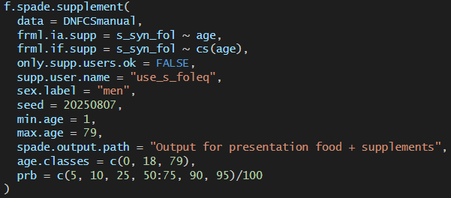
Answer to exercise 1
Code:

Slide 37

Answer to exercise 1
Code:
Results (from tab “HI” of saved excel-file) Mean HI is higher for adults than for youth
For youth: first non-zero percentile is P69
For adults: first non-zero percentile is P74

Slide 38

Answer to exercise 1
Code:
Results (from tab “HI” of saved excel-file) Mean HI is higher for adults than for youth
For youth: first non-zero percentile is P69
For adults: first non-zero percentile is P74
c) All the zero habitual intakes are never-supplement users. We see in the data --------------------------------------------->

Slide 39
Outline 1. Overview submodels SPADE 2. SPADE for supplements 3. SPADE for food + supplements

Slide 40
Example: synthetic folate intakes (females, age 1-79, ~Dutch population)
s_syn_fol
f.spade.supplements
Total intake (w/o zeroes)
Intake from food (w/o zeroes)
Intake from supplements (w/o zeroes)
never supp. users
actually, model food-intake separately for
potential supp. users

Slide 41
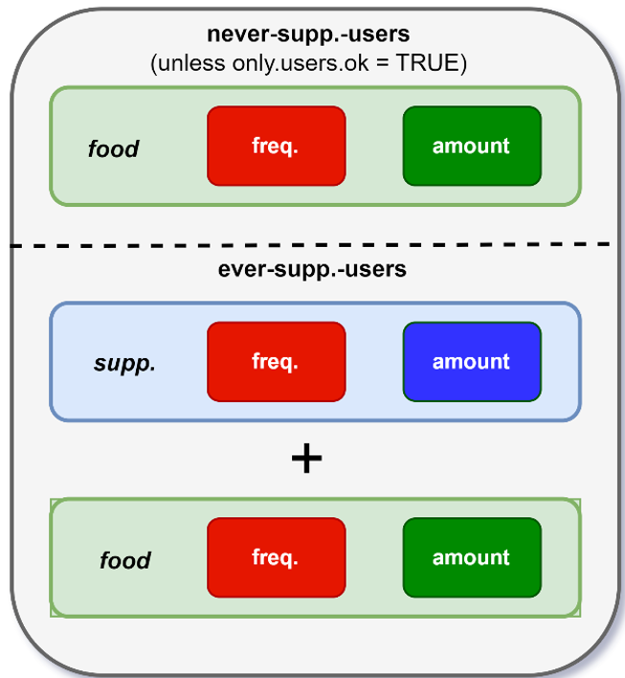
Entire model

Slide 42
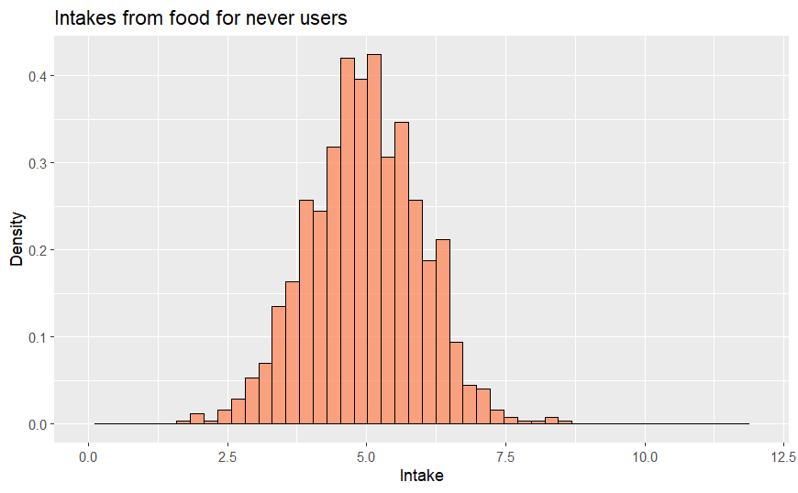
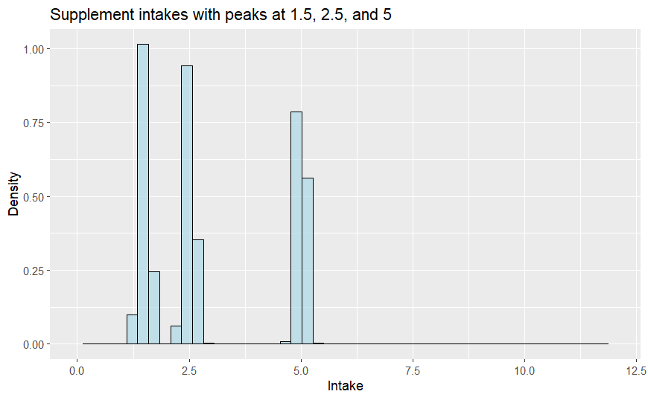
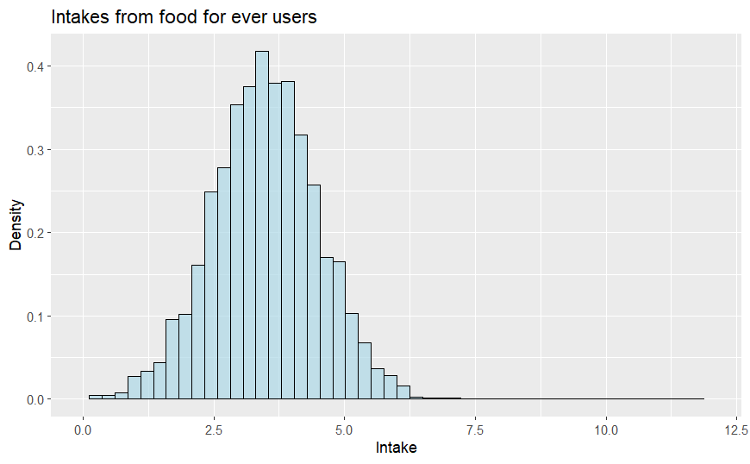
For any fixed age, we model the HI distributions:
Entire model

Slide 43
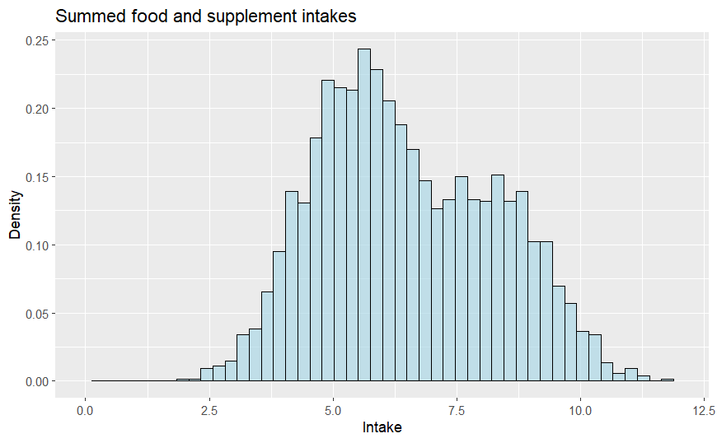
For any fixed age, we model the HI distributions:
Entire model
“add”
Create fake potential supp. users (“pseudo-persons”)
Sample their supp. and food intake (assume uncorrelated)
Add these intakes.

Slide 44
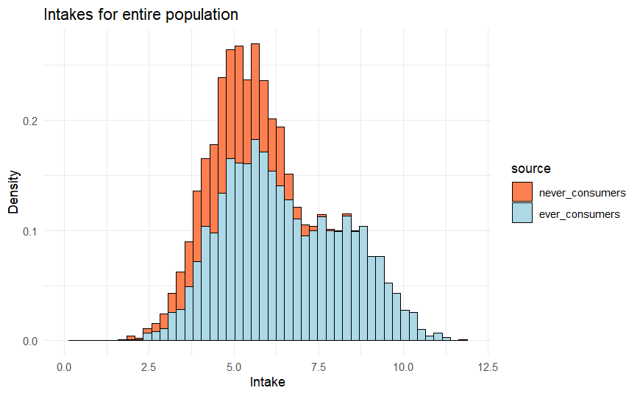
Entire model
HI distr. never supp. users
In this case:
25% of the population is never-user
75% of the population is ever-user
HI distr. entire population
never supp. users ever supp. users
“stack”
HI distr. ever supp. users
“add”
Do this for every age

Slide 45
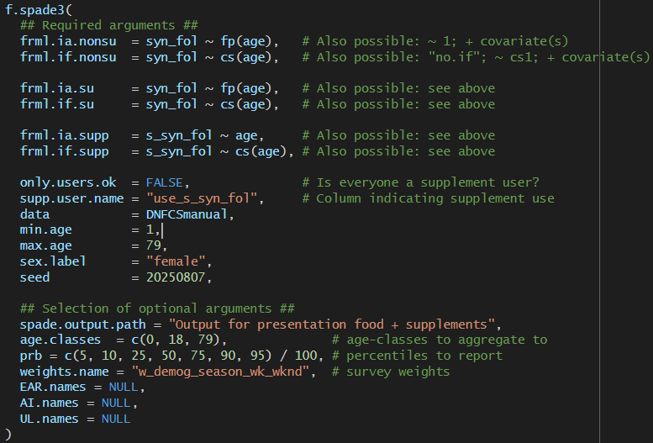
f.spade3 arguments

Slide 46
Let’s inspect the results

Slide 47
Exercise 2
For men in the age-ranges 1-18 and 19-79, use f.spade3 to find the habitual intake distribution of synthetic folate. Make sure your results include: mean (AM), P25, P50, P75, P90, P95. You don’t have to include survey weights.
Compare the food intake from supplement-users with the food intake from never-supplement-users. What do you observe?
Now inspect the total habitual intake distributions, and the contributions from supplements and food. How do the contributions from supplements and food compare? Do youth or adults have a higher intake? Compare this to your finding at exercise 1.

Slide 48
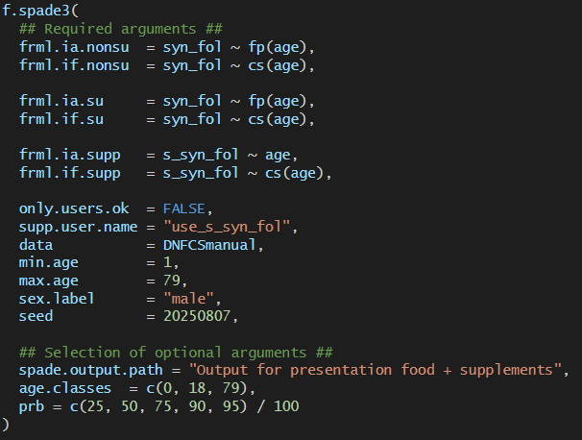
Solution 2a
Code:

Slide 49
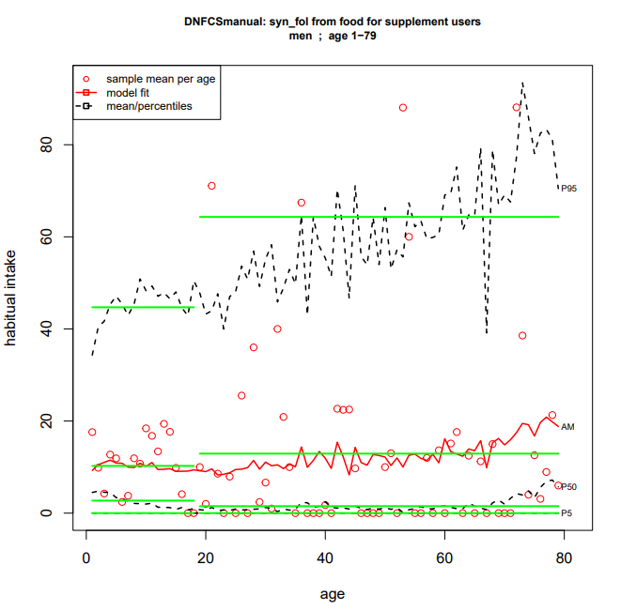
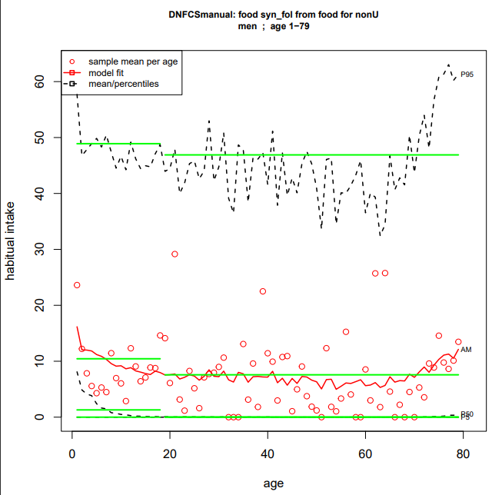

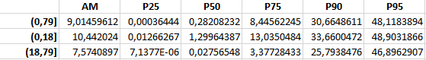
Solution 2b
Food intake by supp. users
Food intake by non-supp. users
Observations: - Right skewed distributions
For youth : food intake supp. seems lower than for non-users
For adults: food intake supp. seems higher than for non-users
But need bootstrap to see if those are significant differences

Slide 50
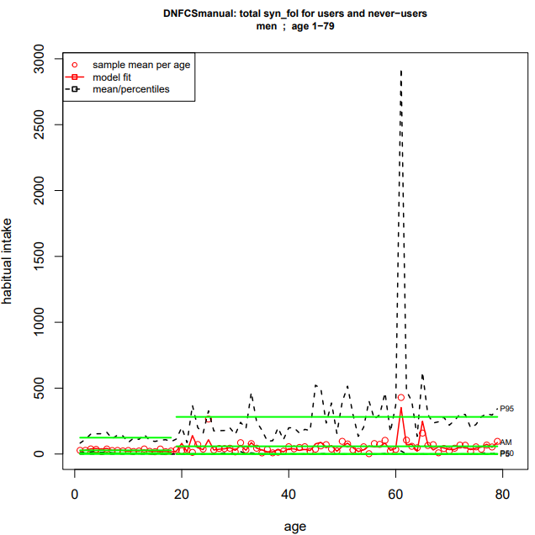

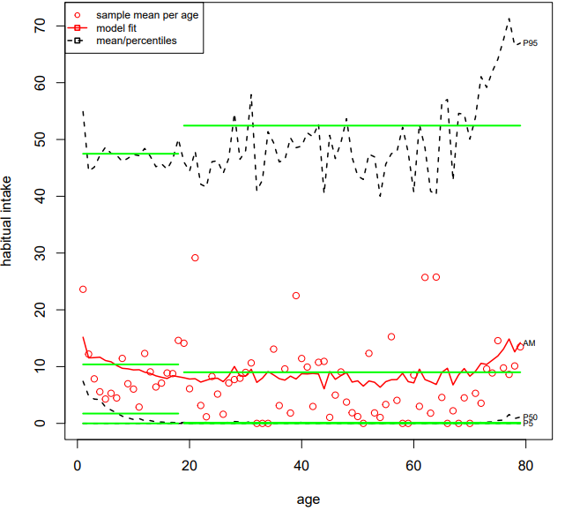
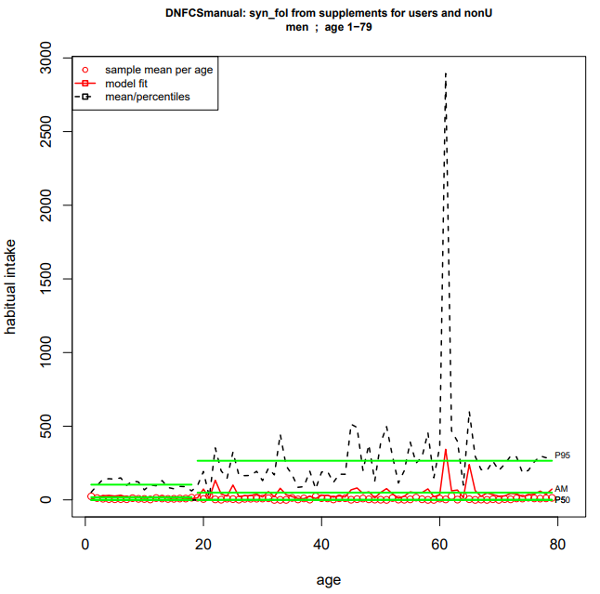
Solution 2c
Total HI distribution
Distribution HI from food
Distribution HI from suppl.
Observations:
Contributions from supplements dominate over contributions from food
Adults have higher HI than youth
We also found this for supplements in the previous exercise

